Slide 1
Trip Planner Application
Dev Dynasty
Justin Makilan, Jayson McShan, Kendall Bliss

Slide 2
Pitch
People/ Users who travel a lot by car often know what cities they are going to go through. To Make it easier to plan a trip, our application allows the user to custom tailor a trip by car. A user puts in their city of origin, their destination city and any intermediate stops between those two points as well as their MPG for the car they will drive. Our Application will let the user know the total distance traveled, the estimated cost for gas and points of interest for each stop the user makes.

Slide 3
Concept
Description
Motivation for Development
User Story
Trip Itinerary Planner that uses Geocoding, Routing, Places API’s to provide users with information about a trip
We wanted to create something that had a practical use in current day to day life
We wanted to create something that was more than just a point to point routing map
As a user who travels a lot by car
I want to enter my start and end points for a trip
So that I can see the route I will take with my possible stops along the way
I want to see the transportation cost based on current prices
So I can determine the total cost of the trip
I want to know points of interest for my stops along my route
So I can decide ahead of time on where I need to stay, where I can eat and other things I can do before I begin my trip

Slide 4
Process
Technologies Used
Breakdown of Tasks and roles
Main Framework
HTML, CSS, JavaScript
Third Party API’s
Materialize, jQuery
Server Side API’s
Graphopper
Geocode, Route
MapQuest
Places
Google Maps
Embedded Map
Dept of Energy EIA API
Fuel cost
Other
MS Visio – Wireframe
Postman API
Live Share VS Code Extension
Main HTML Framework and Research of Materialize CSS framework
Justin Makilan
Materialize Code Work
Jayson McShan, Justin Makilan, Kendall Bliss
Research API
Kendall Bliss, Jason McShan
JavaScript HTML Functions
Jayson McShan, Justin Makilan, Kendall Bliss
JavaScript API functions
Kendall Bliss
Promises
Help from Nikki Reese
We utilized the live share VS Code Extension to work on our code simultaneously during work sessions

Slide 5
Process cont.
Successes
Challenges
Able to successfully combine 3 separate mapping API’s into a single working app
We were able to add in error handling for when API calls failed
Teamwork, able to work effectively as a team with no major issues with merging or pull request
Google Map Embedding
Fuel Cost API
In order to keep the project “free” we had to use some API’s that are not optimized for scalability and some lacked documentation.
Materialize CSS framework lacks functionality
Building the arrays for API’s
API/Function hierarchy (what order the API’s/Functions executed)

Slide 6
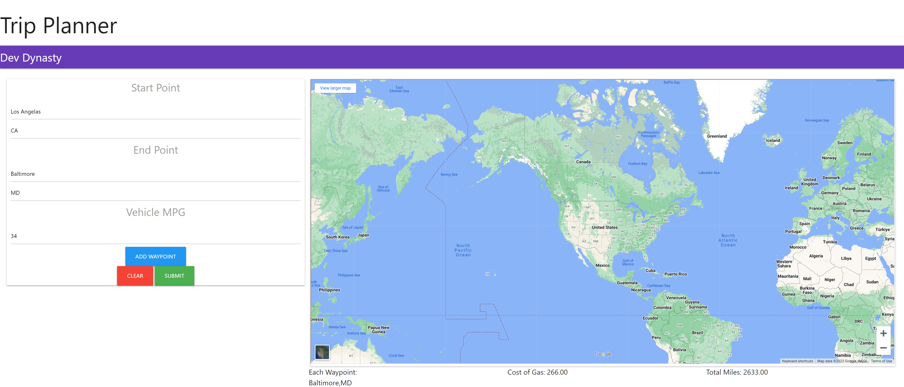
Notes:
Example 1
Start Point: Portland OR
End Point: Atlanta GA
Example 2
Start Point: Portland OR
End Point: Atlanta GA
Way Point 1 Des Moines IA

Slide 7
Directions for future development
Consolidate Map API’s
Use google for all map/routing/place API – google has a library you can import to your page that makes it easy to do everything we do but is not a free service
Utilize Bootstrap/other CSS framework for formatting – Materialize is not robust enough – not clean enough
Instead of using National fuel average, use an average of fuel cost by state in only states that we go through
More robust error handling
Find a more elegant way to store user history
Use a vehicle make/model selector to make it easier to input fuel MPG
Implement ChatGPT or other AI into the trip planner to enhance a users trip itinerary.

Slide 8
Links to Content
GitHub Repository
https://github.com/kbliss86/bootcamp-project-one
Deployed Page
https://kbliss86.github.io/bootcamp-project-one/
API Resources
Google Maps Embedding
https://developers.google.com/maps/documentation/embed/embedding-map
GraphHopper
https://docs.graphhopper.com/#operation/postRoute
MapQuest
Search API - Swagger | MapQuest API Documentation
Fuel Cost
https://www.eia.gov/opendata/browser/petroleum/pri/gnd?frequency=weekly&data=value;&start=2023-07-03&sortColumn=period;&sortDirection=desc;
Materialize
Documentation - Materialize (materializecss.com)

